Slide 1
What is the purpose of grades?

Slide 2
Review the graphs with your team and decide:
Which practice was the most effective for student progress and growth,
Giving a grade,
Giving feedback about what a student did and how they can improve,
Giving both a grade and feedback.

Slide 3
In this class:
1 – All assignments and assessments (projects, labs, and tests) will be directly connected to a standard that you need to master before the end of the year;
2 – Feedback will be given on all student work to identify what you did well and areas that need improvement;
3 – Zeros will not be given;
4 – Late work will be accepted until the Friday before the end of the quarter;
5 – All work can be corrected, improved, and retaken;
6 – Grades will not be given (a place holder grade will be added in the gradebook for assessments only, these are temporary);
7 – Grades will be determined by STUDENT and TEACHER at the end of the quarter through conferencing and evaluating evidence of standards mastery

Slide 4
What if I do not reach proficiency (3) on a standard?
Use the feedback provided to improve your work and resubmit it;
Retake quizzes and tests;
Retakes must be scheduled with Mrs. Davidson;
Missed questions must be corrected;
Evidence must be provided before the retake that additional practice occurred and the student has developed greater understanding.
Remember late work, including retakes and improved work must be submitted NO LATER than the Friday before the end of the quarter.

Slide 5
CLASSROOM PROCEDURES

Slide 6
Starting Class
Enter silently, there is no talking when entering the classroom
Pick up your warm-up (Mondays)
Remove the materials you need for the day from your backpack
Store your backpack on a hook at the end of your table
Record any homework, tests, or project due dates in your agenda
Record the day’s objective on the designated notebook page
Begin working on the warm-up silently and independently

Slide 7
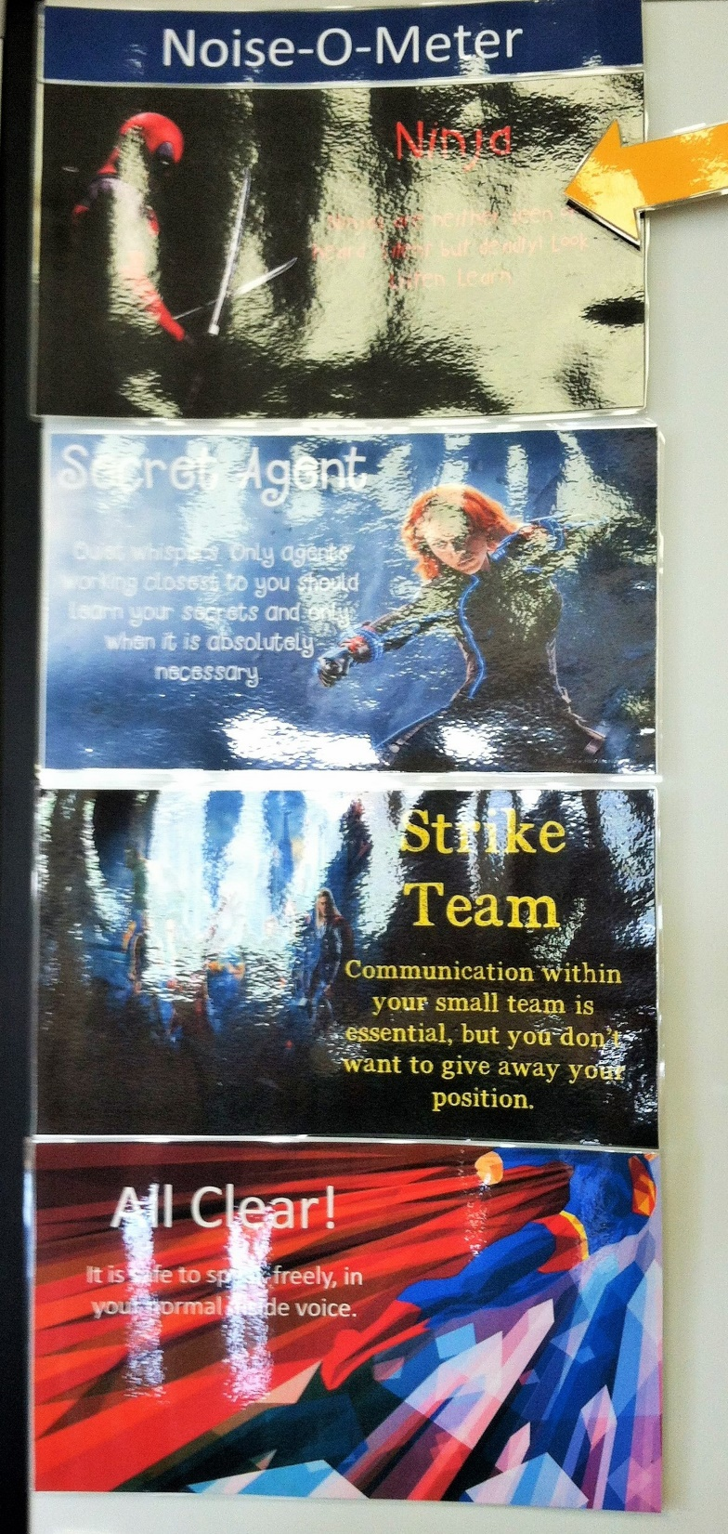
The Noise-O-Meter
Let’s you know what voice level is appropriate for the work in class.
Ninja – Silent
Secret Agent – whisper voice
Strike Team – small group voice
All Clear – presentation voice

Slide 8
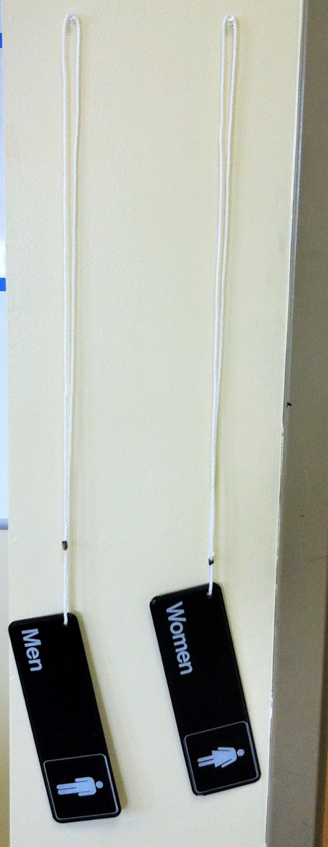
Bathroom Passes
1 boy and 1 girl may leave at a time
You MUST take the hall pass when you leave and place the yellow bathroom cup at your seat so I know you are gone.
When the green sign is posted you are free to go to the bathroom when needed. When the red sign is posted you are not allowed to leave unless it is an emergency.

Slide 9
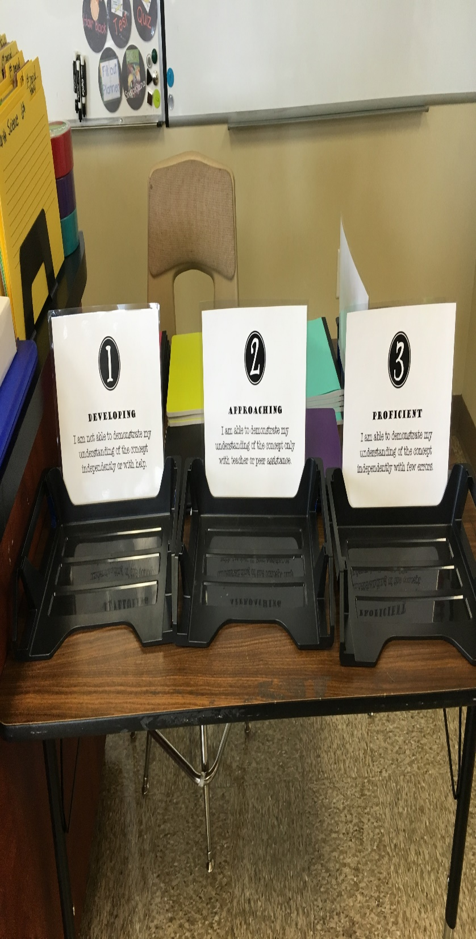
Exit Tickets
Before leaving class each day you will be asked to evaluate your learning for that day. Place your exit ticket in the basket that best reflects your understanding of the topic that day.
3 – I am able to demonstrate my understanding independently.
2 – I am able to demonstrate my understanding only with help.
1 – I do not understand.

Slide 10
Successful Teams
Members
Participate
Listen
Complete their responsibilities
Share
All team members have a job to help their team run smoothly and be successful.

Slide 11
Team Responsibilities
Member A = Absent Secretary
Record the day’s activities and assignments on an absent form with the team member’s name. Attach any handouts and place in the absent file for your class period.

Slide 12
Member B = Materials Manager
Provide and put away all team materials. Restock supplies when you run out.

Slide 13
Member C = Sanitation Manager
Checks work area to make sure team mates have cleaned their space. NOT responsible for cleaning other’s messes. Empty team trash.

Slide 14
Member D = Voice Level Monitor/Substitute
Ensure your team is working in the proper noise level mode and issue reminders for those who need them. Fill in to complete other group member jobs when team mates are absent.

Slide 15
Member E = Paper Manager
Pass out and collect all paper work for your team.

Slide 16
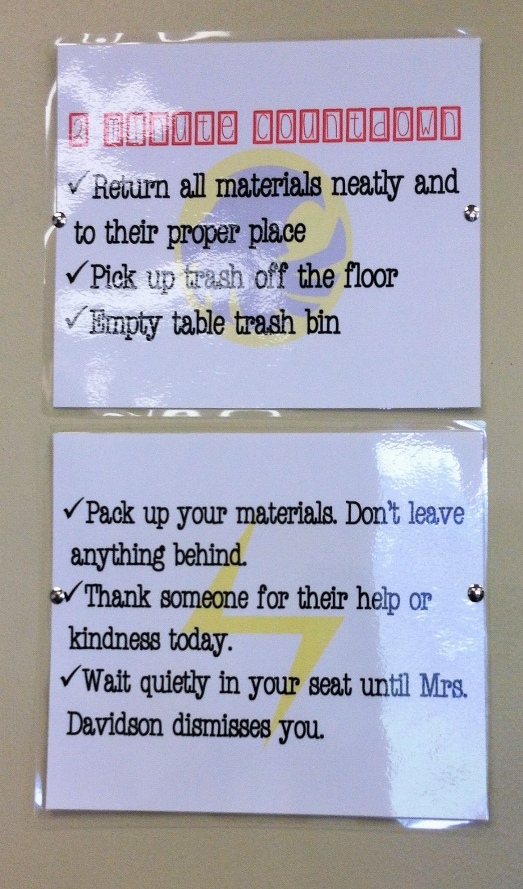
Preparing for the End of Class
When the alarm goes off this is your signal to stop what you are doing, complete the exit ticket, clean up your work space, and prepare to leave.

Slide 17
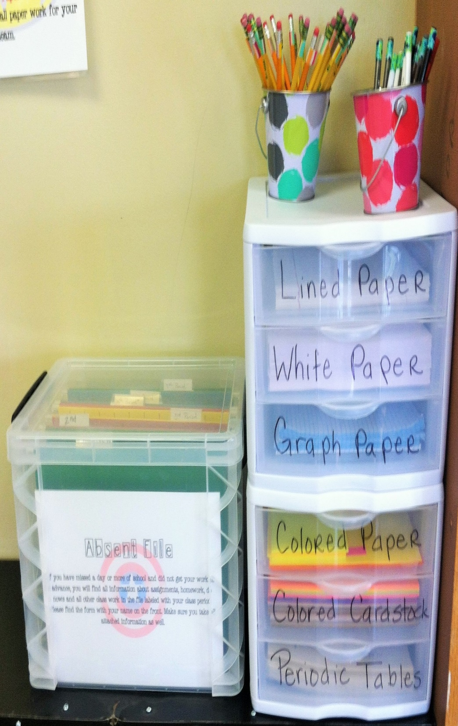
Supplies
Pens, pencils, and paper for classroom use can be found in this cabinet.
If you are absent you are responsible for finding your work here and then asking questions if you do not understand.

Slide 18
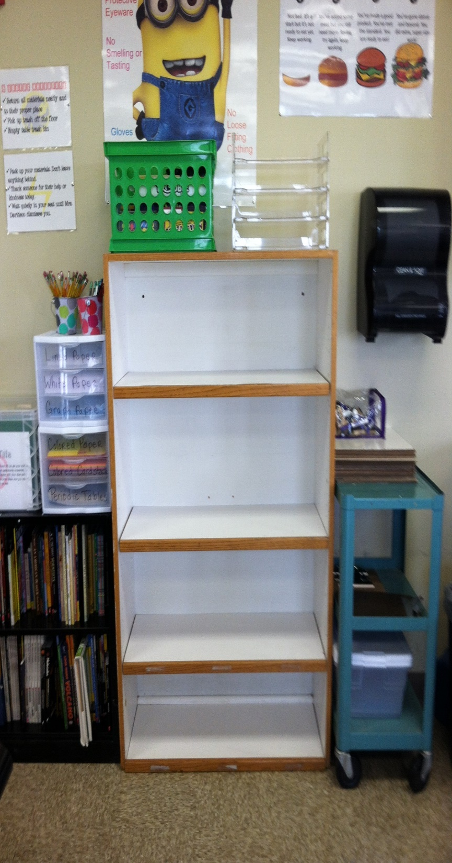
Notebooks
Students are welcome to store their notebooks on these shelves at the end of the class period. Please store them neatly and with your class period.
6th
7th
8th

Slide 19
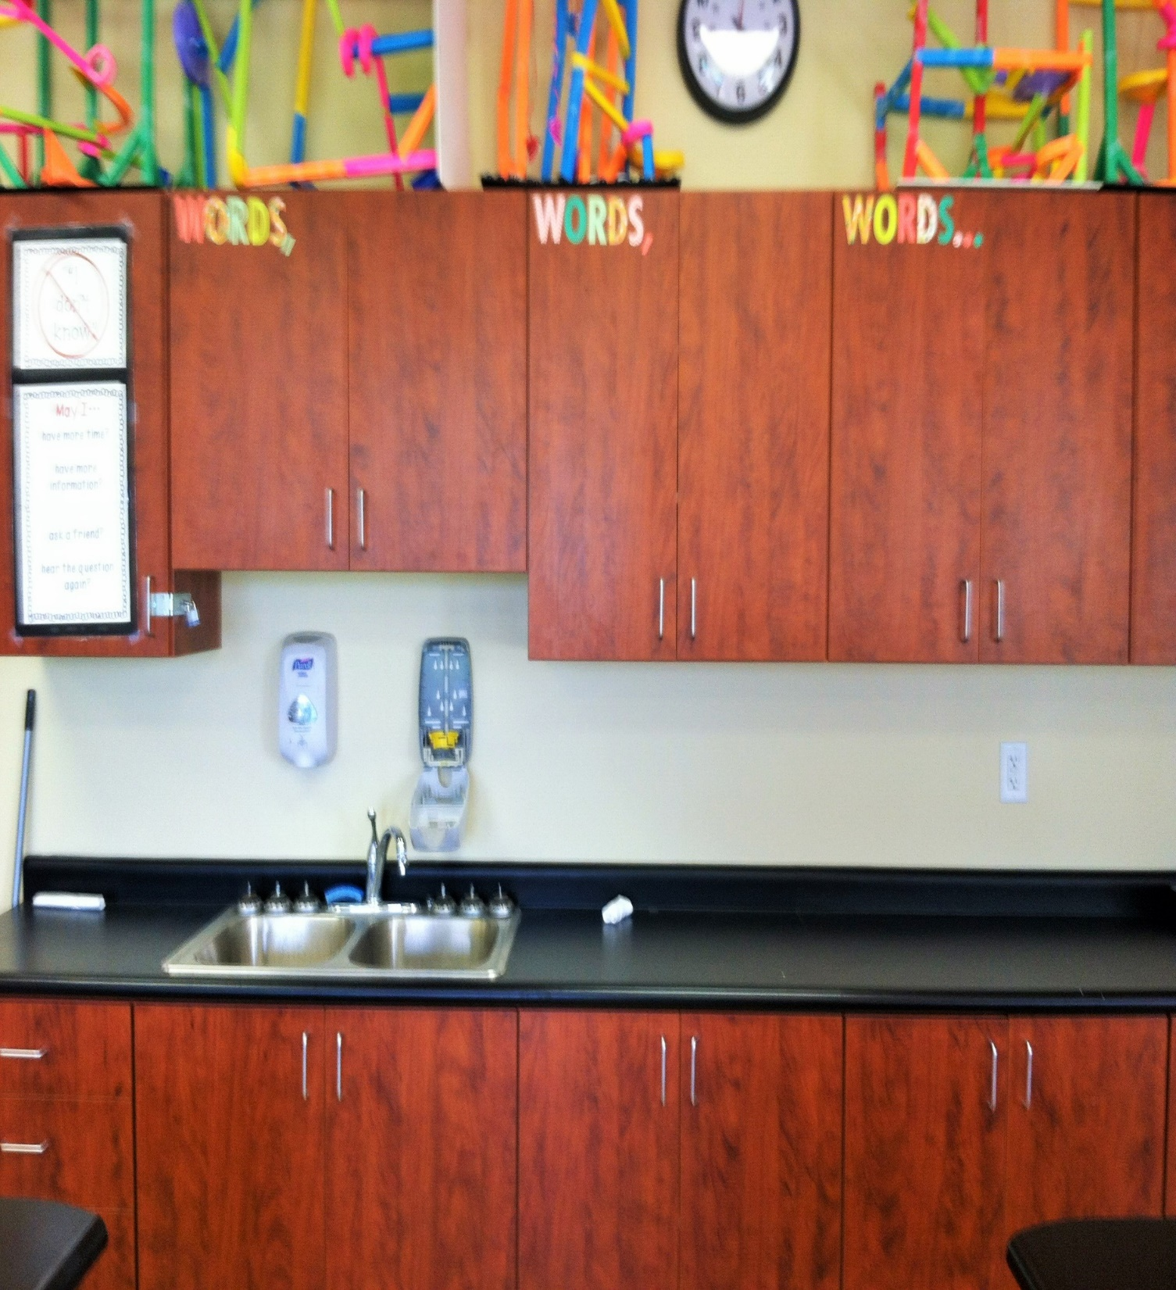
Our Vocabulary Word Cabinet
The go to place to find all terms you need to know.

Slide 20
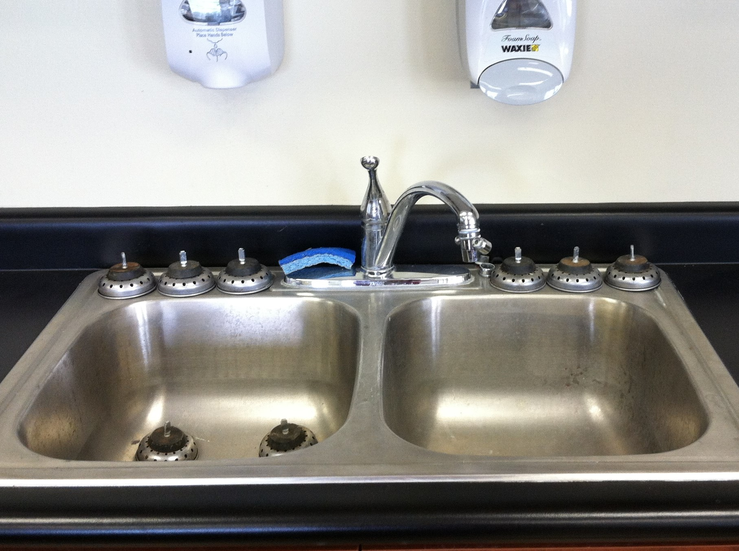
Classroom Drinking Fountain
Please avoid getting drinks while Mrs. Davidson is teaching.

Slide 21
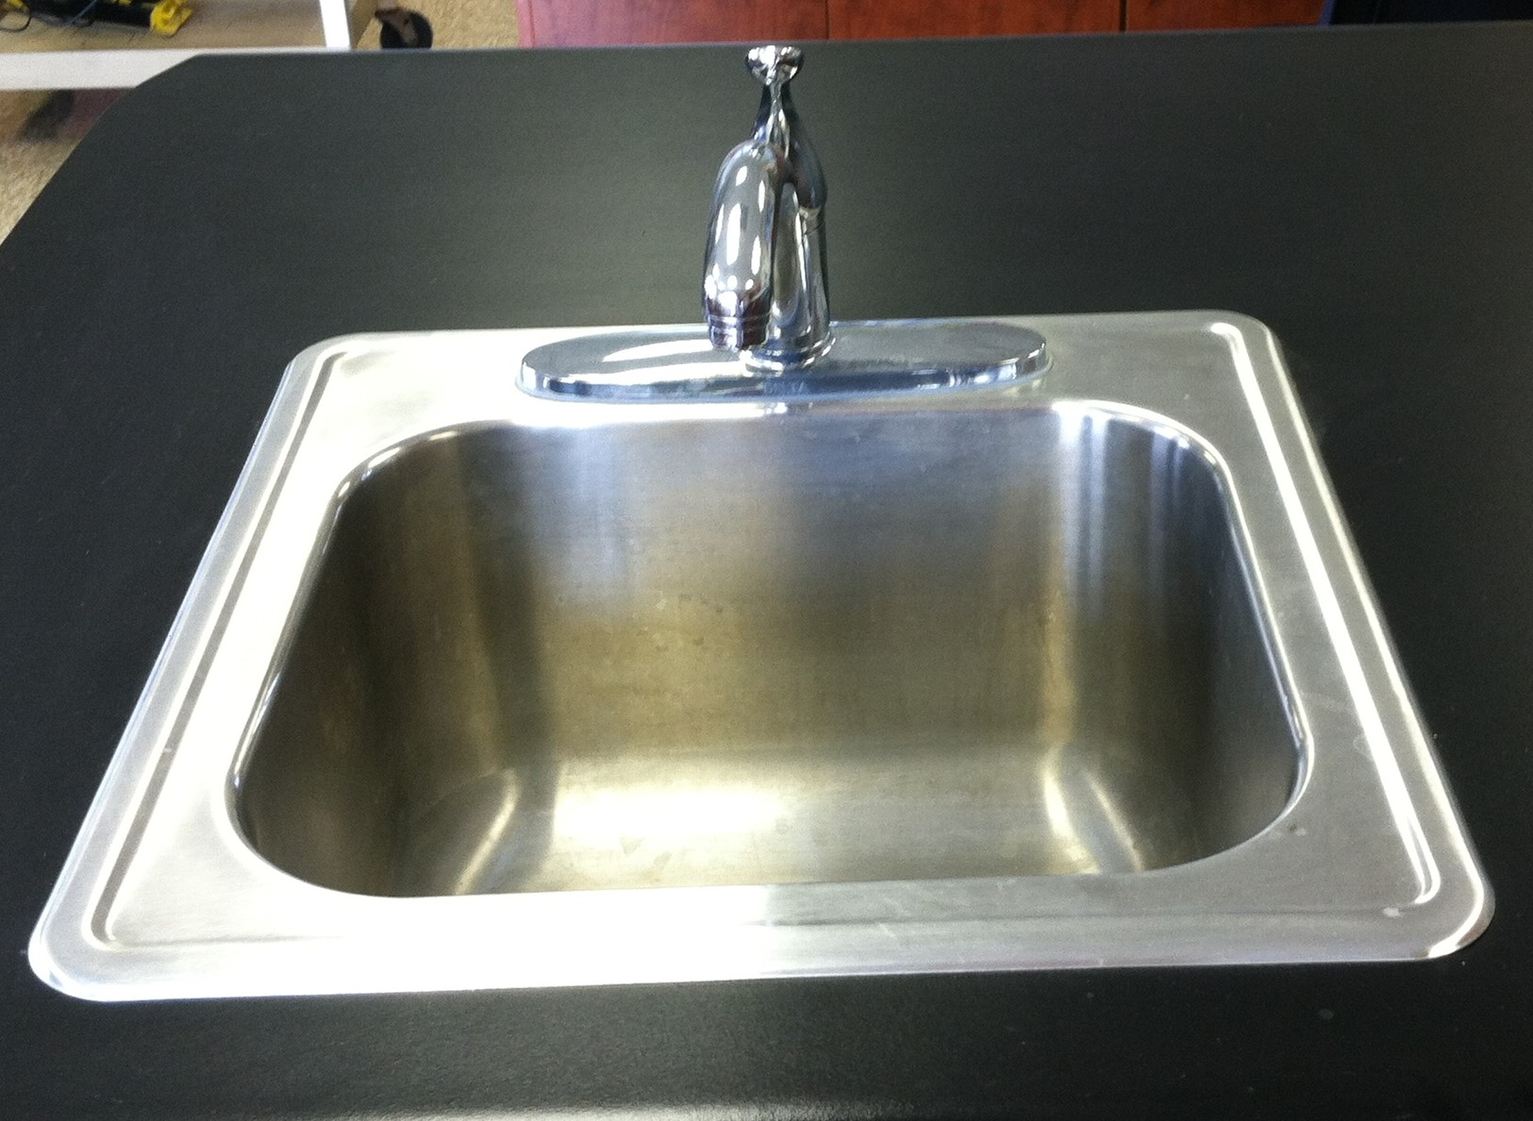
Hands off sinks unless they are needed for an investigation.

Slide 22
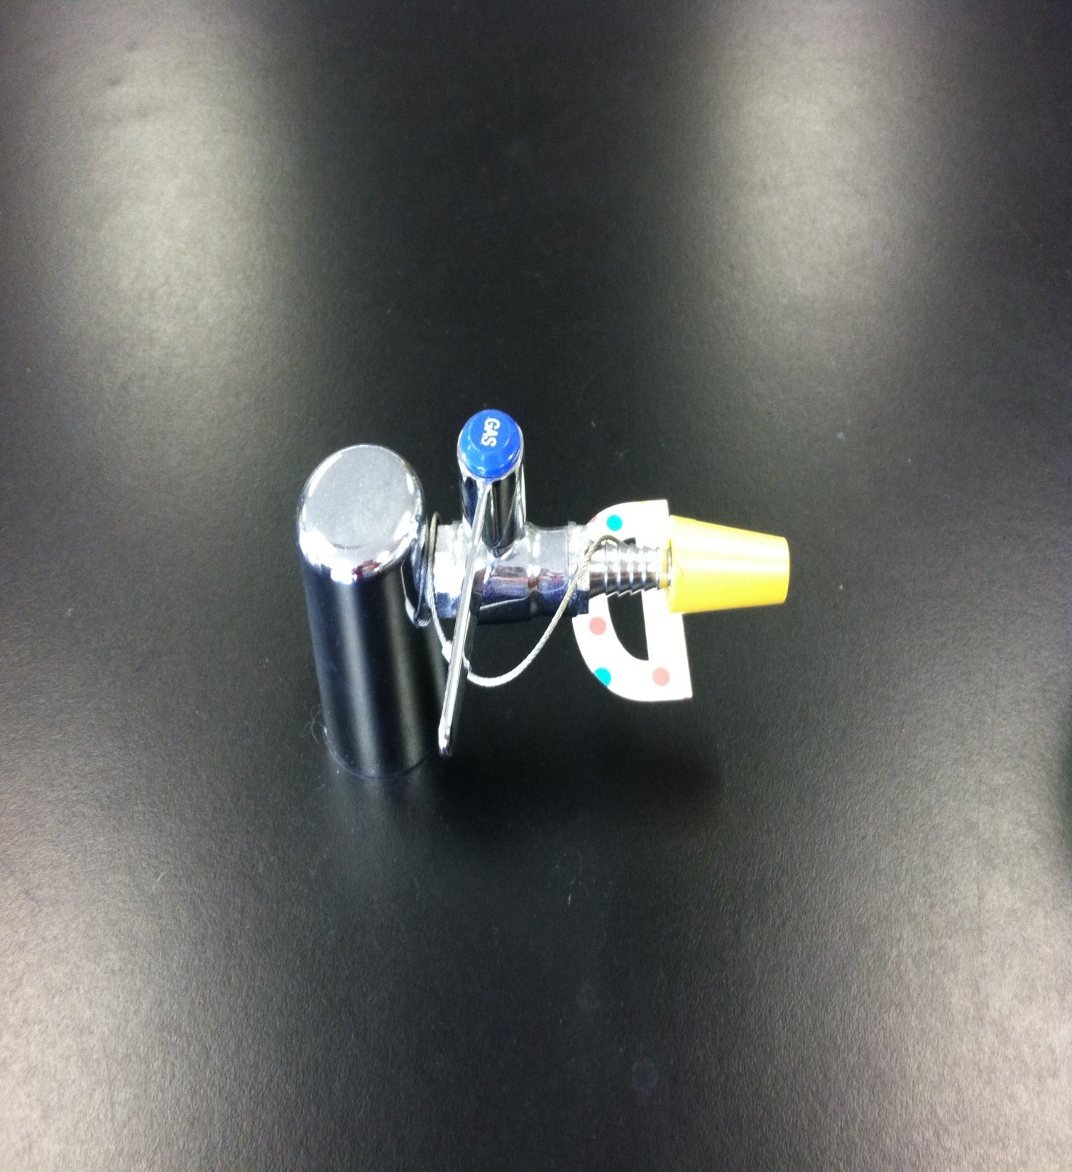
Hands off the gas valves!

Slide 23
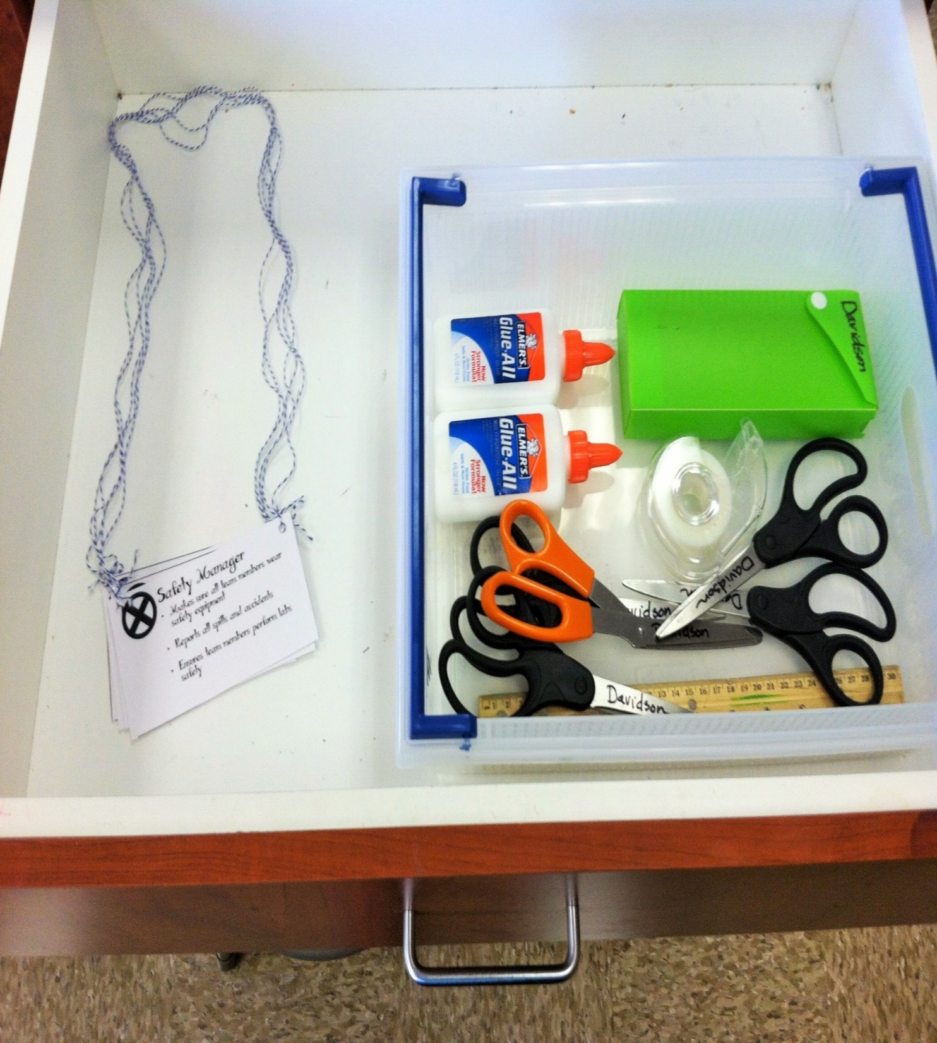
Team Materials
Please store all materials neatly in the basket in the drawer. You will not be excused if your team hasn’t done their job.

